Slide 1
ROC Curve and Lift Chart Presentation Didem Bulut Aykurt 12/16/2022 MSI510-1 Dr. Emmanuel Tsukerman

Slide 2
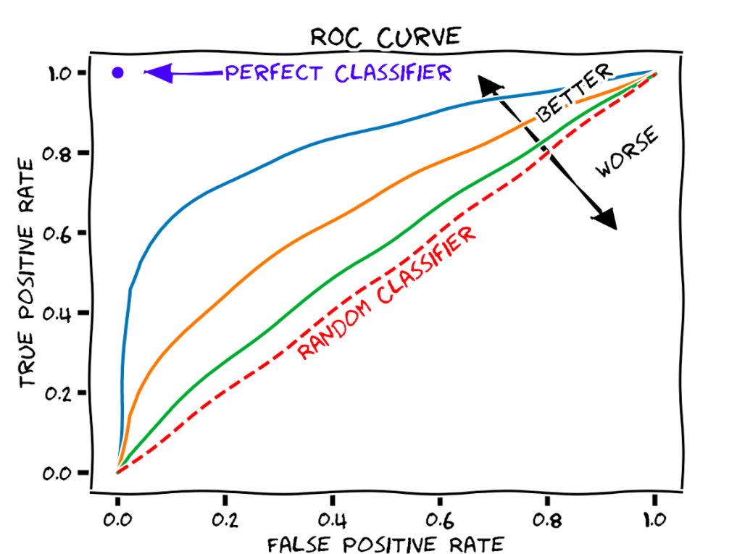
Interpretation of ROC Curves
ROC means receiver operating characteristic helps to evaluate the caliber of classification models’ performance with aspect to the false positive rate(FPR) and true positive rate(TPR).
The ROC curve techniques calculate by variable the decision inception of the classifier.
This method helps with contingent models, which forecast the probabilities of the type.
Right side chart has three different lines that could be trained with different parameters.
One red dash line is a diagonal line describing random guessing.
Perfect classifier point 1 any model line close to the point that is better than other and random classifier.
The ROC curve close and below the random classifier means a worse model.
Different curves concern different models, and each has a different area under the curve.
Figure 1: Receiver Operating Characteristic (ROC) curve with False Positive Rate and True Positive Rate. The diagonal shows the performance of a random classifier. Three example classifiers (blue, orange, green) are shown. [2]

Slide 3
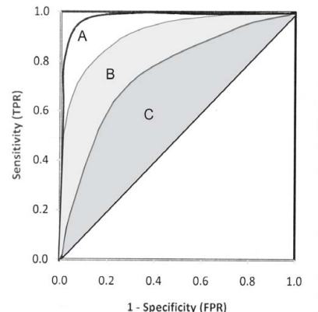
Area Under ROC Curve (AUROC)
The area under the ROC curve calculates the area to distinguish the performance of a classification model.
The AUC’s value ranges from 0 to 1 as if a score of 0.5 means the entire random prediction. Higher than 0.5 shows better than random.
Ideal margin is the true positive rate (TPR) adjacent to 1 and false positive rate (FPR) adjacent to 0.
True Positive rate (TPR) = True Positive(TP)/(TP+FN)
False Positive rate (FPR) = False Positive(FP)/(FP+TN)
Result of TPR is higher than the value of false negative is lower, which means almost all positives are forecast correctly.
The result of FPR is lower than the false positive value, which means almost all negatives are forecast correctly.
Figure 2 shows that model A is better than B and C.
Figure 2: Comparison of three smooth ROC curves with different areas.[3]

Slide 4
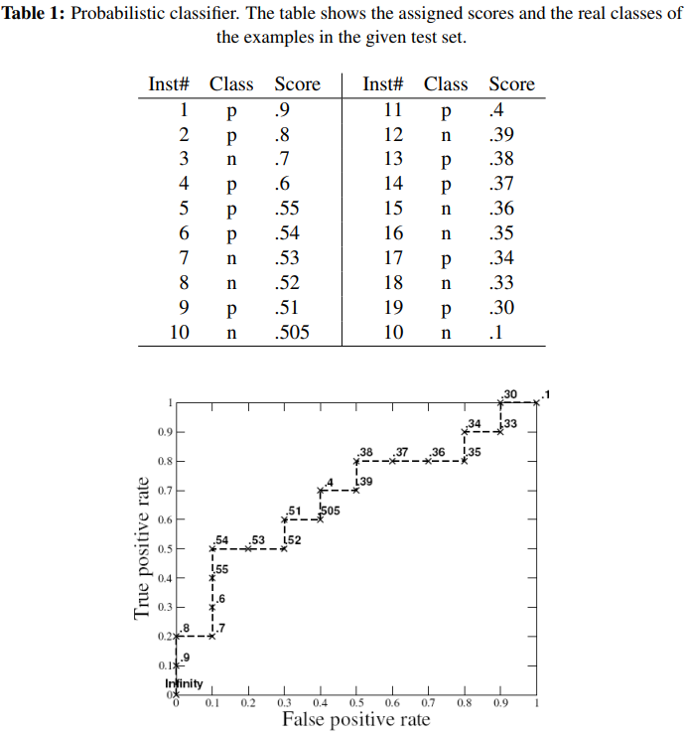
ROC Curve with the research of alarm system
This research’s main topic for ROC curve, lift chart, and calibration plot.
Fire alarms in the training set have diagnoses including class ‘fire’ or ‘not fire.’ Then applied to the test set of the alarm system are attributes’ values. A classifier that makes a binary prediction (i.e., the alarm is either true or false) or a classifier that gives a probabilistic class prediction to which class an example belongs. “The first is called a binary classifier, and the latter is called a probabilistic classifier.”
They used an alarm system that part of the alarms was caused by positive events( certainly fire an alarm), and part of the alarms were caused by adverse events.
The ratio between positive and negative events as the figure 3 ROC graph’s parameters are x is false positive and y is truly positive.
Test set has a binary classifier set of points on the graph. The ROC curve for the classifier.
Figure 3: ROC graph of the probabilistic classifier from Table 1. Thresholds are also marked on the graph.[1]

Slide 5
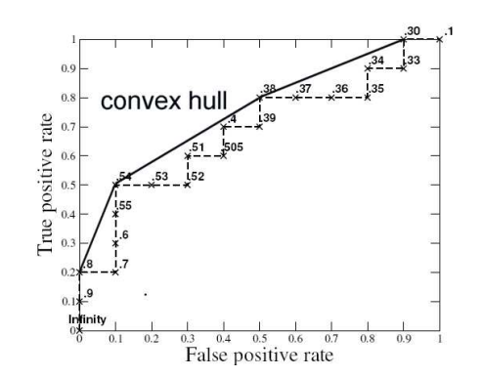
Convex hull and ROC curve Conclusion
There are different ways to make a curve with this data point; the most common one is a convex hull shown on the chart.
Build a binary classifier for each point on the convex hull. Each line has two endpoints that correspond to classifiers.
Convex hull is just one approximate build of a ROC curve from all sets of points.
ROC curve help to find stochastic models that forecast the possibility of one or more classes.
Different ROC curves are conceivably generated on different features.
If the ROC curve is below the random guessing classifier line, the model can be repudiated.
Figure 4: ROC graph with a convex hull of the probabilistic classifier from Table 1. [1]

Slide 6
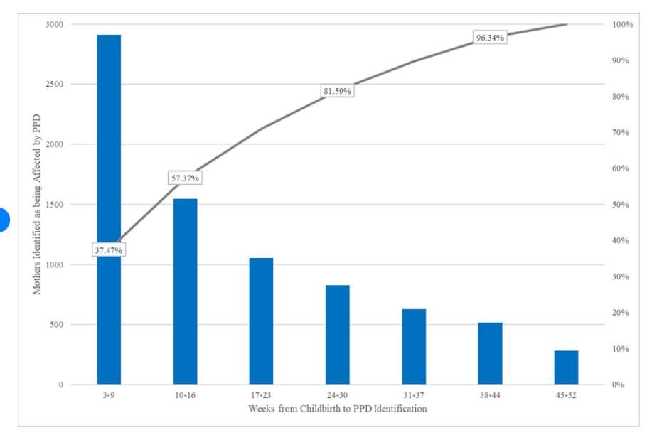
Interpretation of Lift Chart
The lift chart ameliorates and evaluates the classification mining model anticipate when contrasted in case of random guess and calculates the different terms of lift score for other models.
The chart can say which model is better or worse and which predictions are mostly useless.
The lift chart help to compare the accuracy for multiple models with the same predictable ascribe.
Besides evaluating forecast precision for either a single outcome or all outcomes.
Figure 4, the lift chart groups a range of age bins for each bar to execute decreasing conviction of the model for the intention class. The chart tells leading confidence values in the first bin, second, third, and so on.
The chart comprises two parts. The first bar side helps find the correct aspiration class percentage. The second part line shows increasing coverage of the intention class.
Figure 4: Time from Childbirth to Postpartum Depression Diagnosis or Possible Treatment.[4]

Slide 7
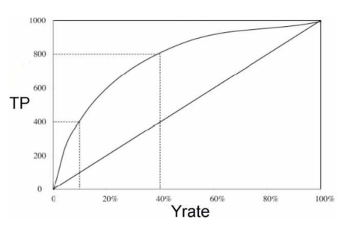
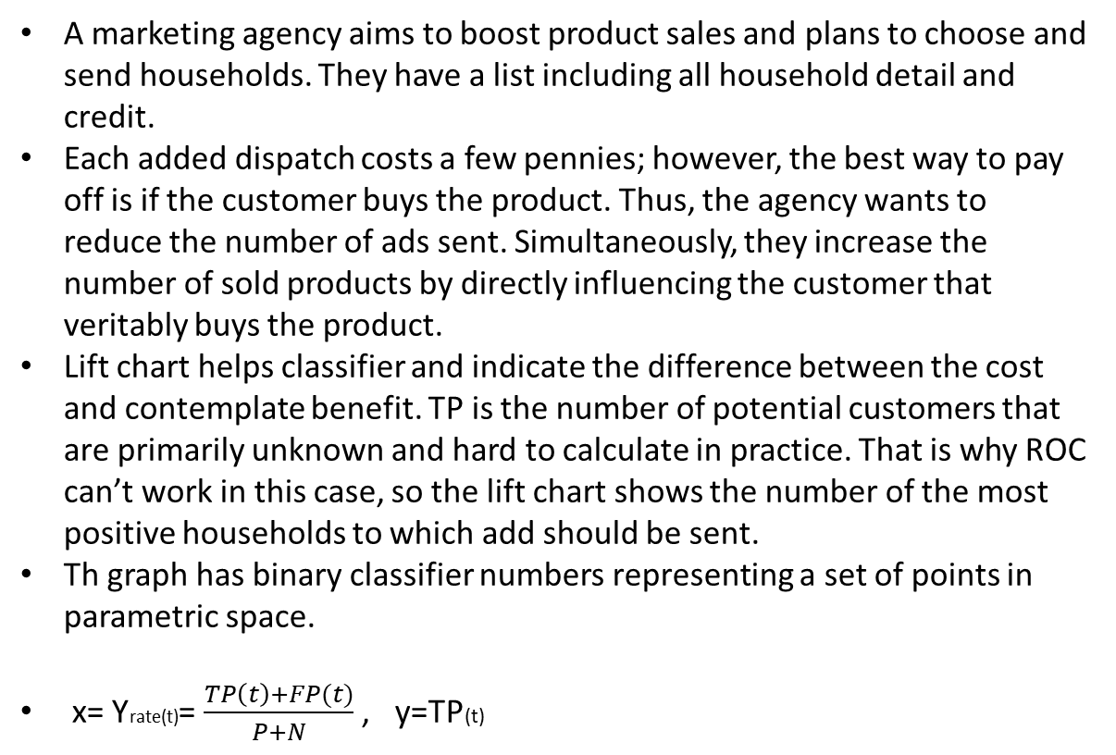
Lift Chart for a Marketing Agency
A marketing agency aims to boost product sales and plans to choose and send households. They have a list including all household detail and credit.
Each added dispatch costs a few pennies; however, the best way to pay off is if the customer buys the product. Thus, the agency wants to reduce the number of ads sent. Simultaneously, they increase the number of sold products by directly influencing the customer that veritably buys the product.
Lift chart helps classifier and indicate the difference between the cost and contemplate benefit. TP is the number of potential customers that are primarily unknown and hard to calculate in practice. That is why ROC can’t work in this case, so the lift chart shows the number of the most positive households to which add should be sent.
Th graph has binary classifier numbers representing a set of points in parametric space.
x= Yrate(t)= $\frac{TP\left(t\right)+FP(t)}{P+N}$ , y=TP(t)
Figure 5: A typical marketing lift char for sending advertisements to 1000 households.[1]

Slide 8
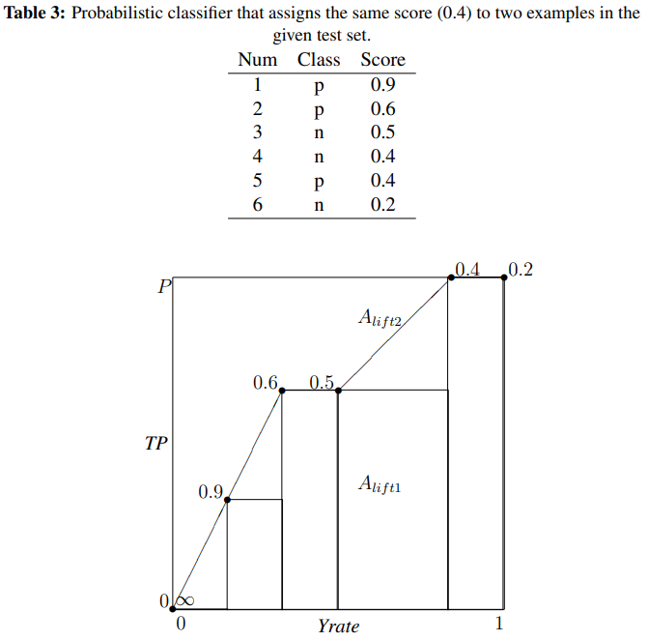
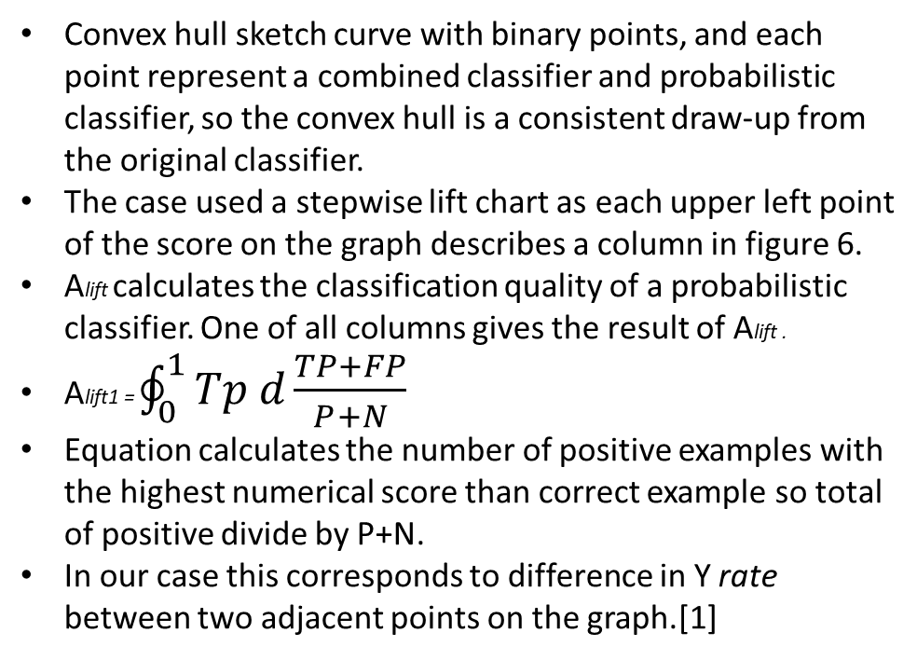
Conclusion of AUC-Lift Chart
Convex hull sketch curve with binary points, and each point represent a combined classifier and probabilistic classifier, so the convex hull is a consistent draw-up from the original classifier.
The case used a stepwise lift chart as each upper left point of the score on the graph describes a column in figure 6.
Alift calculates the classification quality of a probabilistic classifier. One of all columns gives the result of Alift .
Alift1 = $\oint_{0}^{1}{Tp d\frac{TP+FP}{P+N}}$
Equation calculates the number of positive examples with the highest numerical score than correct example so total of positive divide by P+N.
In our case this corresponds to difference in Y rate between two adjacent points on the graph.[1]
Figure 6: Methods Alift1 on data from Table 3.[1]

Slide 9
References
[1] Miha Vuk, Tomaz Curk, & Metodoloski zvezki(2006). ROC Curve, Lift Chart and Calibration Plot
http://mrvar.fdv.uni-lj.si/pub/mz/mz3.1/vuk.pdf
[2] ROC Curve Chart https://commons.wikimedia.org/wiki/File:Roc_curve.svg#filelinks
[3] Mr Rajeev Kumar, Department of Biostatistics and Medical Informatics, University College of Medical Sciences, Delhi. Receiver Operation Characteristic (ROC) Curve for Medical Researchs
https://www.indianpediatrics.net/apr2011/277.pdf
[4] Healthcare resource utilization and costs associated with postpartum depression among commercially insured households - Scientific Figure on ResearchGate. https://www.researchgate.net/figure/Time-from-Childbirth-to-Postpartum-Depression-Diagnosis-or-Possible-Treatment-a-b-A-c-c-e_fig2_343145680 [accessed 16 Dec, 2022]

